Slide 1

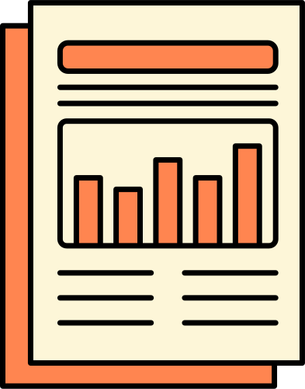


Remote Work & Health Impact 2025
Ardian Ibnurosyidianto

Slide 2

Ardian Ibnurosyidianto
My name is Ardian Ibnurosyidianto, a graduate of Informatics Engineering from Universitas Muhammadiyah Surakarta, with a strong passion for data analysis and visualization. I believe that data is more than just numbers when processed and presented properly, it becomes a powerful tool for making smart decisions.
I have hands-on experience using Microsoft Excel and Power BI to clean, analyze, and visualize data through interactive dashboards and insightful reports. I am a detail-oriented, fast learner who enjoys turning complex datasets into meaningful insights.
Currently, I’m building a professional portfolio to showcase my skills as a Junior Data Analyst, and I’m eager to grow in a collaborative, innovative, and data-driven work environment.

Slide 3
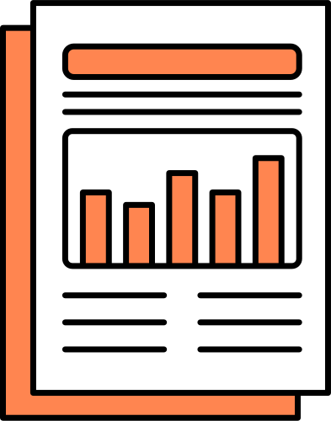

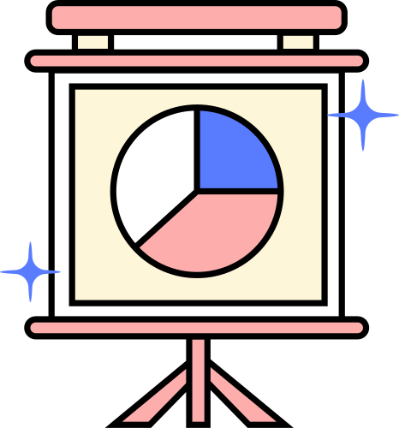
About Project
Remote Work & Health Impact 2025 is a data analysis project focused on understanding how different work arrangements—onsite, hybrid, and remote—affect employees' well-being.
This project leverages survey data from 3,157 respondents across various industries, providing insights into work–life balance, mental health indicators, burnout levels, and working hours.
Using Power BI, I conducted comprehensive data exploration and visualization to uncover patterns and correlations that can inform better workplace strategies.
The purpose of this project is to demonstrate my ability to translate complex data into actionable insights, supporting data-driven decisions in HR and organizational development.

Slide 4

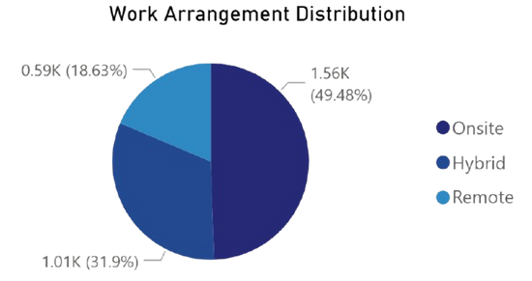
Work Arrangement Distribution
This pie chart presents the distribution of work arrangements among all respondents. The majority still work onsite, followed by those in hybrid and remote setups. This breakdown provides a clear context for understanding how different working environments might influence employees’ mental health, work–life balance, and burnout levels, which will be explored in the next sections.

Slide 5
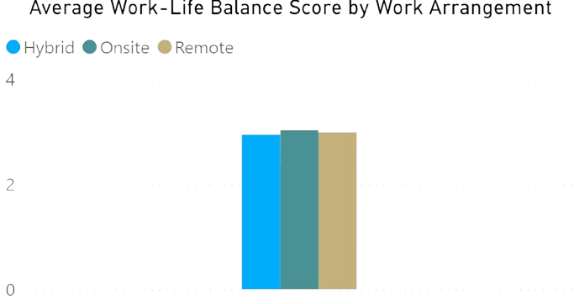
Work–Life Balance Across Work Models
Onsite shows the highest work–life balance score, followed by hybrid and remote. The small gap suggests that other factors may also influence overall balance.

Slide 6
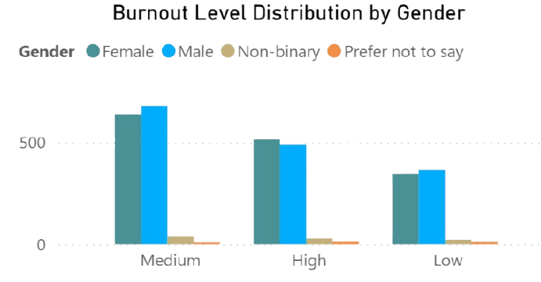


Burnout Levels by Gender
Looking at burnout levels by gender, we see that both male and female respondents most commonly report medium burnout. High and low levels are less frequent but still present. Interestingly, other gender identities report fewer cases, which might be due to lower representation or reluctance to disclose. This highlights how burnout is a shared experience, but its expression and reporting can vary based on personal and social factors.

Slide 7

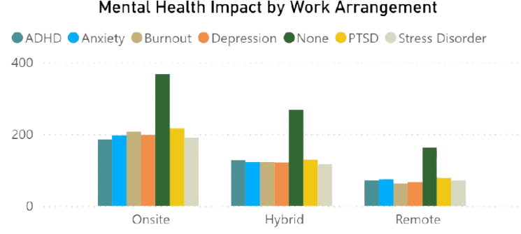
Mental Health Impact by Work Arrangement.
This chart shows how different work arrangements relate to mental health impacts. Interestingly, onsite workers report the highest rates of depression, anxiety, and burnout symptoms. Remote workers, while often perceived as having more flexibility, also show signs of emotional fatigue, though slightly less. Hybrid workers tend to report the lowest impact overall. These findings suggest that work setting alone doesn’t determine mental well-being — support systems, workload, and work culture also play a major role.

Slide 8

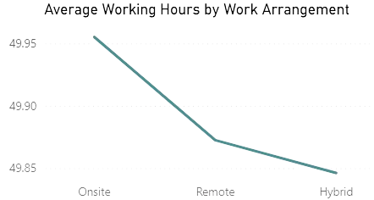
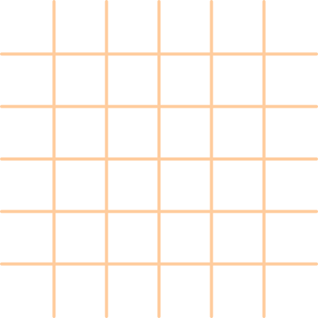
Average Working Hours by Work Arrangement
Despite assumptions that remote or hybrid workers might work less, the data shows only a slight difference. Onsite employees average slightly more hours per week than those working remotely or in hybrid setups. Though minimal, this gap suggests that flexibility may allow for better time allocation and work-life balance, without significantly reducing productivity.

Slide 9

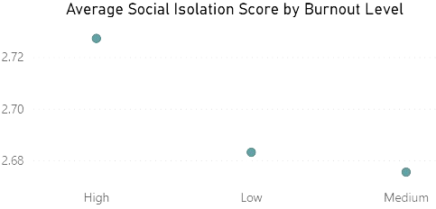

Social Isolation by Burnout Level
The data shows a clear connection between burnout and feelings of social isolation. Individuals experiencing high burnout levels reported the highest average isolation scores. In contrast, those with medium and low burnout levels felt less isolated. This insight highlights how mental fatigue and emotional exhaustion can intensify the sense of disconnection at work, especially in remote or hybrid settings.

Slide 10

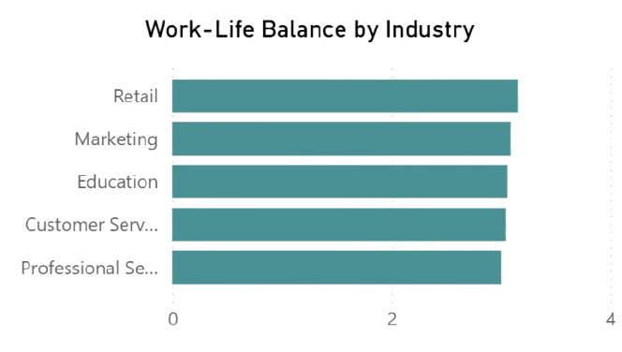
Work–Life Balance by Industry
Work–life balance perceptions differ slightly across industries. Retail leads with the highest average score, while professional services and customer support follow closely. Despite the small variation in scores, this data reflects how certain job sectors may offer more flexibility or support in managing work and personal life. Understanding these differences can help organizations tailor wellness initiatives specific to their industry context.

Slide 11



REFERENCE
https://www.kaggle.com/datasets/pratyushpuri/remote-work-health-impact-survey-2025

Slide 12


Thank You
🔗 I’m open to data-related opportunities feel free to explore more of my work on LinkedIn and GitHub.
https://www.linkedin.com/in/ardian-ibnurosyidianto-125144227/
https://github.com/ardianibnu11

